Slide 1
冒險故事(VTube Studio)

Slide 2
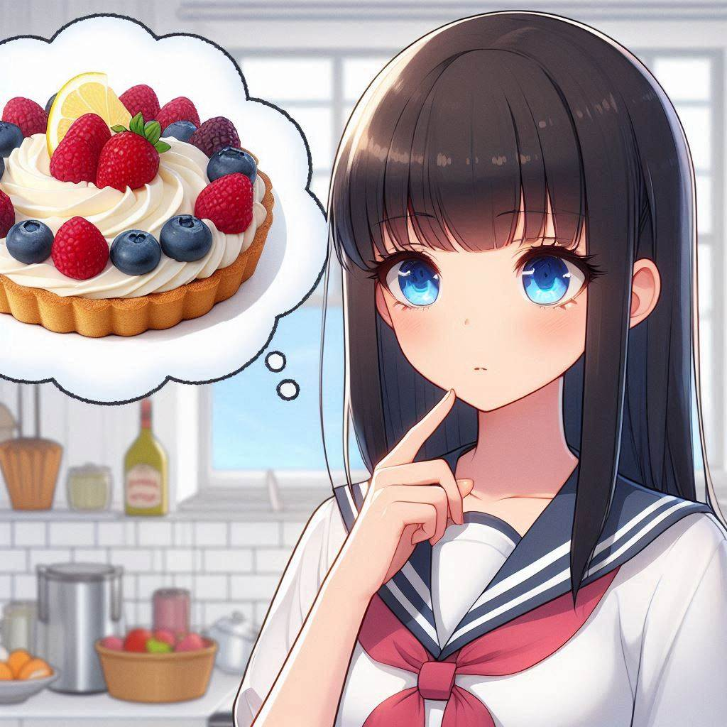
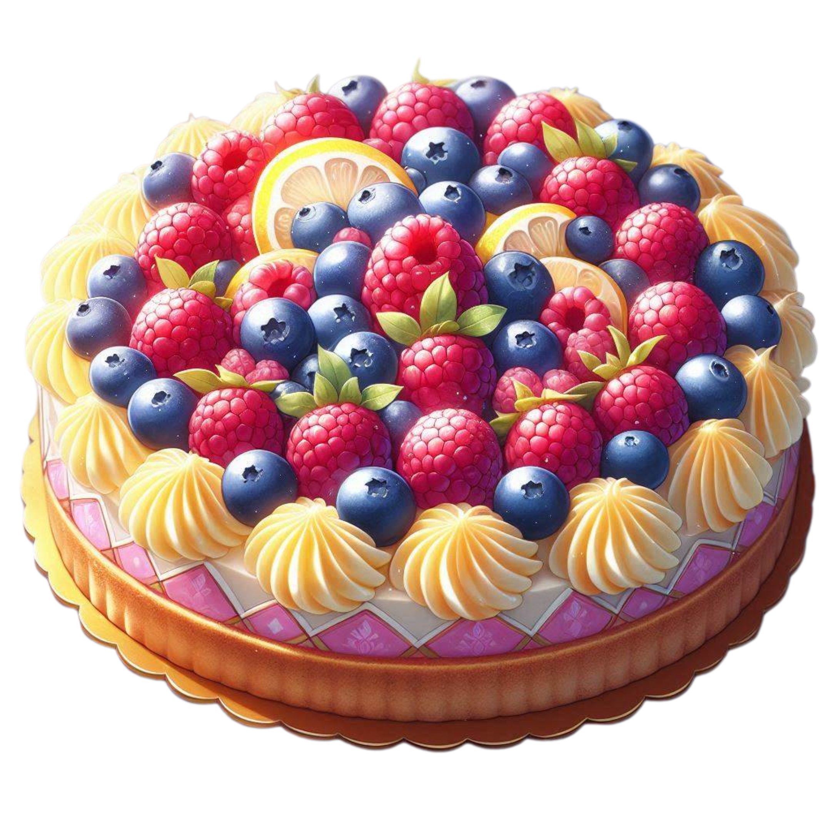
Notes:
Build a Japanese anime style scene.
A girl is standing in the kitchen, thinking about a dessert.
That dessert was a berry lemon tart. Raspberries and blueberries paired with crispy tart crust and lemon frosting.
The girl's appearance is chest-length straight black hair, flat bangs, and blue eyes. A high school girl wearing a white sailor uniform.
And please carefully draw the details of the anime-style berry lemon tart.
我第一次參加烘焙比賽時滿懷期待，希望能讓大家品嚐到我設計的甜點。
當時，我準備了一款名為“莓果檸檬塔”的甜點，

Slide 3



Notes:
Generate a scene in Japanese anime style. A girl is in a baking competition (the background is a big kitchen with many pastry chefs competing) Girl holding a single layer berry lemon tart (containing blueberries, raspberries and lemon frosting) with a sad expression. The girl's appearance is chest-length straight black hair, flat bangs, and blue eyes. A high school girl wearing a white sailor uniform.
覆盆子和藍莓搭配酥脆的塔皮和檸檬糖霜，整個甜點應該要讓人有一種清爽又幸福的感覺。

Slide 4

Notes:
Build a Japanese anime style scene. A girl is in the baking competition venue (a large kitchen), carrying simple tools and looking uneasy. The girl's appearance is chest-length straight black hair, flat bangs, and blue eyes. A high school girl wearing a white sailor uniform.
比賽當天，我早早到達現場。
當我走進比賽區域，看到四周的參賽者時，心裡不禁打起鼓來。

Slide 5
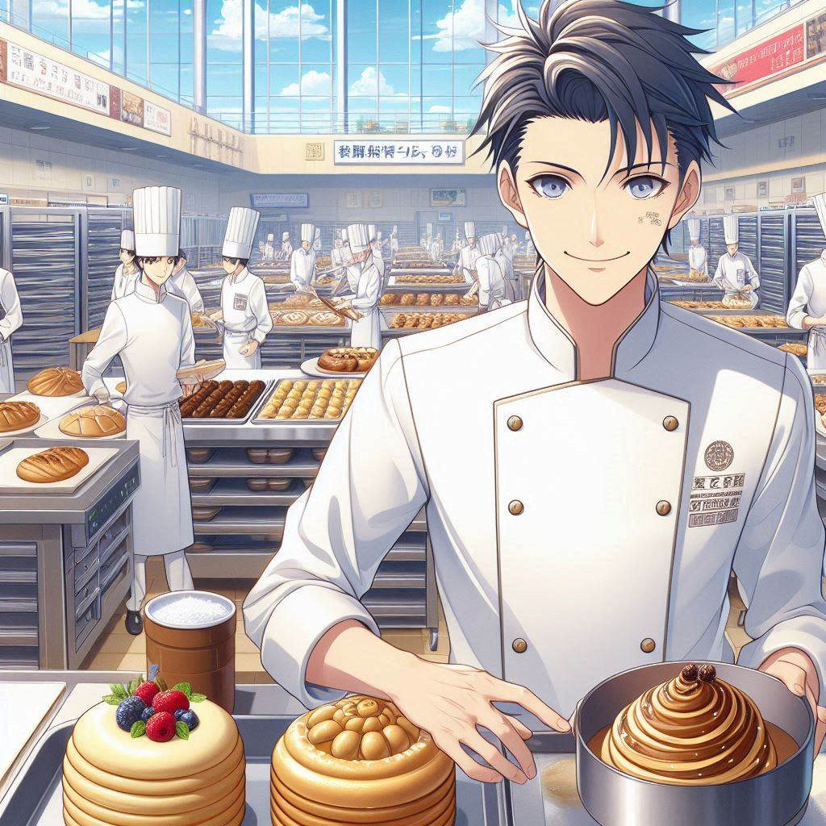
Notes:
Build a Japanese anime style scene.
In a baking competition scene (a large kitchen), there are many pastry chefs wearing chef robes and carrying very professional baking equipment.
Please close up one of the pastry chefs and his baking equipment.
其他參賽者看起來經驗豐富，裝備精良，

Slide 6
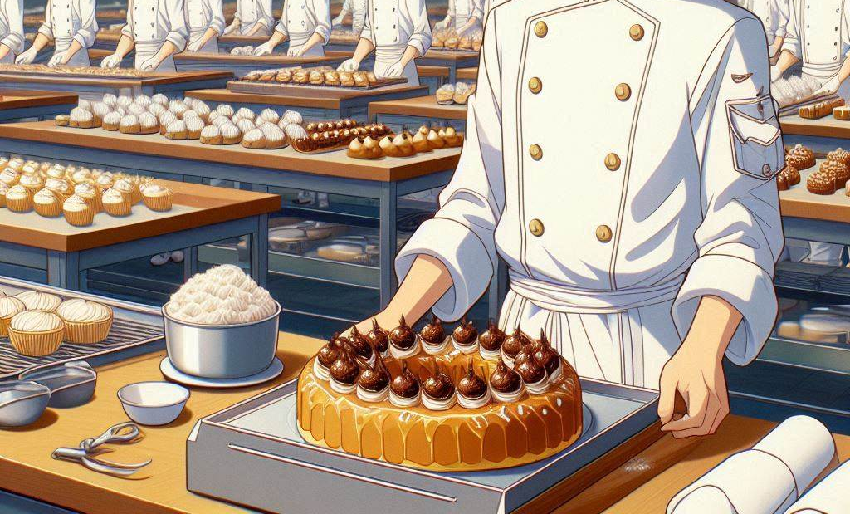
Notes:
甚至還有專業級的烘焙工具。

Slide 7

Notes:
Build a Japanese anime style scene. A girl is in the baking competition venue (a large kitchen), carrying simple tools and looking uneasy. The girl's appearance is chest-length straight black hair, flat bangs, and blue eyes. A high school girl wearing a white sailor uniform.
而我只是帶著家裡的工具和準備的食材，內心有些不安。
但我告訴自己，我來這裡是為了挑戰自己。

Slide 8

Notes:
Build a Japanese anime style scene. A girl is baking the crust of a tart in the baking competition venue (a large kitchen). There is a pie plate on the table, and the girl is spreading the tart crust on the pie plate with her hands in her hands. The girl's appearance is chest-length straight black hair, flat bangs, and blue eyes. Wearing a white sailor suit.
隨著比賽開始的鈴聲響起，我開始忙碌地製作甜點。
首先製作塔皮時 一切都很順利，

Slide 9


Notes:
Build a Japanese anime style scene. A girl is baking a tower in the baking competition venue (a large kitchen). The girl is spreading blueberries and raspberries on the pie (the pie is a single layer). The girl's appearance is chest-length straight black hair, flat bangs, and blue eyes. Wearing a white sailor suit.
隨著比賽開始的鈴聲響起，我開始忙碌地製作甜點。
首先製作塔皮時 一切都很順利，

Slide 10
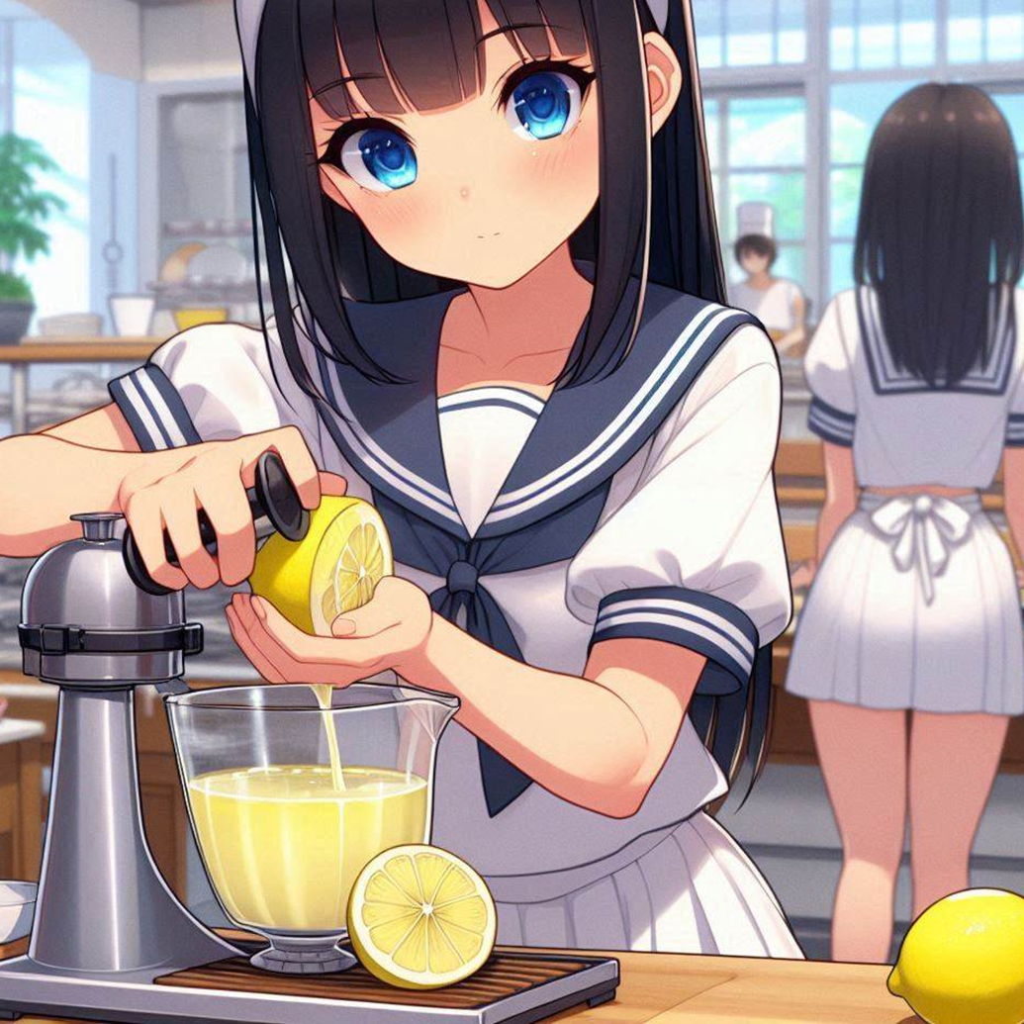
Notes:
Build a Japanese anime style scene. A girl squeezes lemon juice in the baking competition venue (a large kitchen). The girl's appearance is chest-length straight black hair, flat bangs, and blue eyes. Wearing a white sailor suit.
首先製作塔皮時 一切都很順利，
然而，當我進行到檸檬糖霜這一步時，一個意外發生了。

Slide 11

Notes:
Build a Japanese anime style scene. A girl in a baking competition venue (a big kitchen) She accidentally knocked over the lemon juice on the table and looked very nervous. The girl's appearance is chest-length straight black hair, flat bangs, and blue eyes. Wearing a white sailor suit.
我不小心打翻了檸檬汁，準備的檸檬也不夠多。

Slide 12
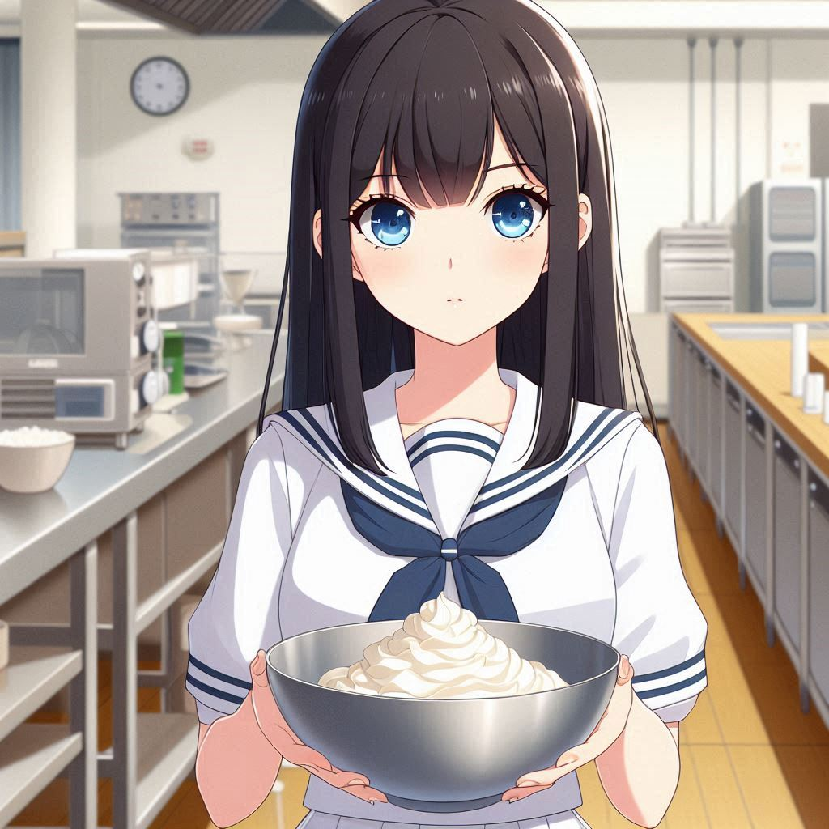
Notes:
Build a Japanese anime style scene. A girl in the baking competition venue (a large kitchen). She was holding a bowl with white chocolate in it. The girl's appearance is chest-length straight black hair, flat bangs, and blue eyes. Wearing a white sailor suit.
我瞬間感到手足無措，但也馬上冷靜下來

Slide 13
Notes:
Build a Japanese anime style scene. A girl in the baking competition venue (a large kitchen). She was holding a bowl with white chocolate in it. The girl's appearance is chest-length straight black hair, flat bangs, and blue eyes. Wearing a white sailor suit.
決定減少檸檬糖霜的用量，改用白巧克力來補救。

Slide 14

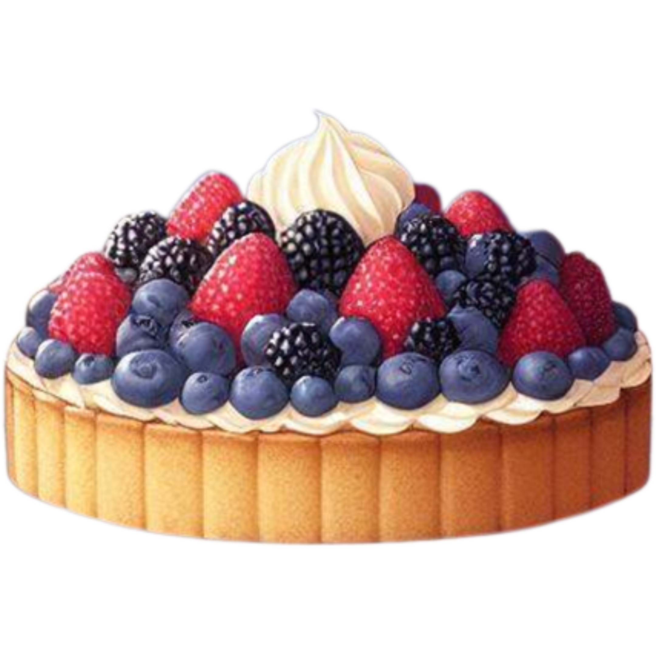
Notes:
Generate a scene in Japanese anime style. A girl is in a baking competition (the background is a big kitchen with many pastry chefs competing) Girl holding a single layer berry lemon tart (containing blueberries, raspberries and lemon frosting) with a sad expression. The girl's appearance is chest-length straight black hair, flat bangs, and blue eyes. A high school girl wearing a white sailor uniform.
當我最終完成這款甜點時，比賽的時間也結束了。我看著自己面前的作品，心裡五味雜陳。

Slide 15



Notes:
Generate a scene in Japanese anime style. A girl is in a baking competition (the background is a big kitchen with many pastry chefs competing) Girl holding a single layer berry lemon tart (containing blueberries, raspberries and lemon frosting) with a sad expression. The girl's appearance is chest-length straight black hair, flat bangs, and blue eyes. A high school girl wearing a white sailor uniform.
這不是我原本想像中的“莓果檸檬塔”，少了一點檸檬的清新，多了一些白巧克力的甜膩。

Slide 16

Notes:
Generate a scene in Japanese anime style. In the baking competition (the background is a large kitchen with many pastry chefs competing), There are three middle-aged judges at the front eating the contestants' desserts and discussing the scores.
接著，評審們逐一走到參賽者的桌前品嚐作品

Slide 17
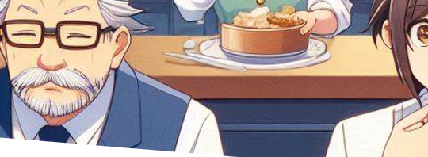
Notes:
Generate a scene in Japanese anime style. In the baking competition (the background is a large kitchen with many pastry chefs competing), There are three middle-aged judges at the front eating the contestants' desserts and discussing the scores.
我緊張地等待比賽的結果

Slide 18

Notes:
Build a Japanese anime style scene. A girl was at the baking competition venue (the background was a large kitchen with many pastry chefs competing), looking very lost and sad. The girl's appearance is chest-length straight black hair, flat bangs, and blue eyes. Wearing a white sailor suit.
我緊張地等待比賽的結果

Slide 19

Notes:
Generate a scene in Japanese anime style. In the baking competition (the background is a large kitchen with many pastry chefs competing), A host announces the top three winners from the front.
最終，主持人宣布了前三名的得獎者。

Slide 20
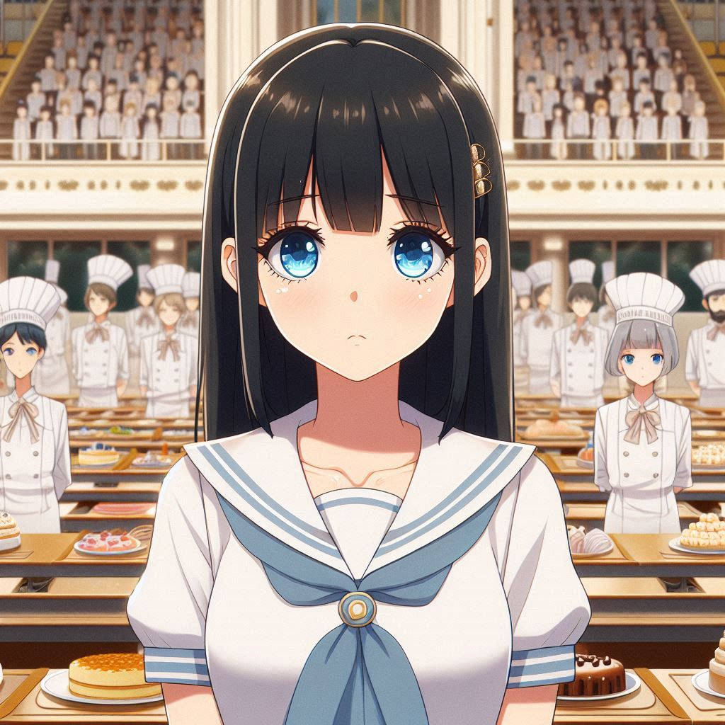
Notes:
Build a Japanese anime style scene. A girl was at the baking competition venue (the background was a large kitchen with many pastry chefs competing), looking very lost and sad. The girl's appearance is chest-length straight black hair, flat bangs, and blue eyes. Wearing a white sailor suit.
當沒有聽到我的名字出現在前三名時，心裡不免感到失落

Slide 21
Notes:
Build a Japanese anime style scene. A girl was at the baking competition venue (the background was a large kitchen with many pastry chefs competing), looking very lost and sad. The girl's appearance is chest-length straight black hair, flat bangs, and blue eyes. Wearing a white sailor suit.
我以為自己的努力沒有得到回報。

Slide 22
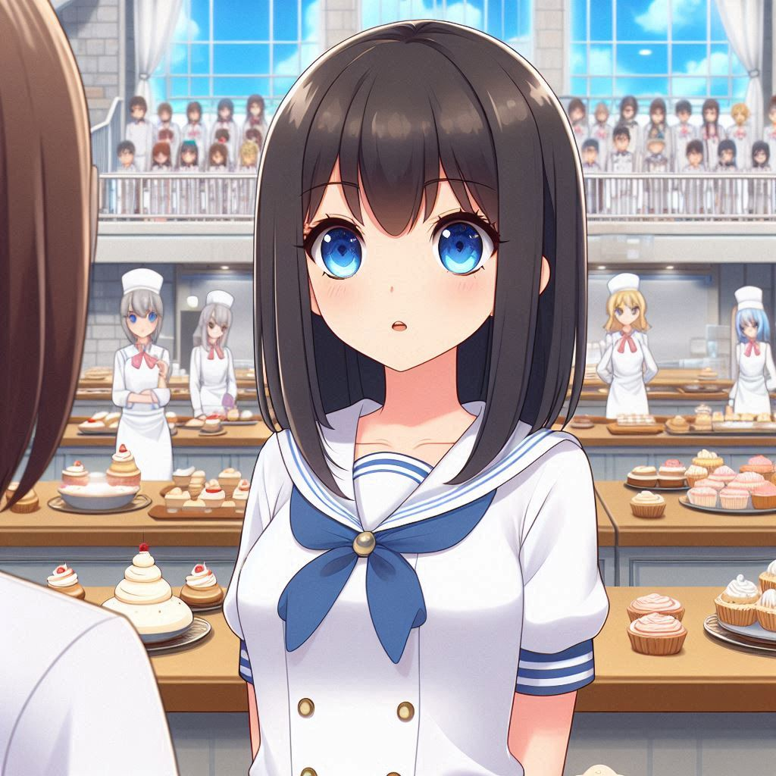
Notes:
Build a Japanese anime style scene. A girl at a baking competition venue (with a large kitchen in the background). The girl's appearance is chest-length straight black hair, flat bangs, and blue eyes. Wearing a white sailor suit. A teacher is talking to her.
然而比賽後，有一個評審老師找到我，

Slide 23

Notes:
Build a Japanese anime style scene. A girl at a baking competition venue (with a large kitchen in the background). The girl's appearance is chest-length straight black hair, flat bangs, and blue eyes. Wearing a white sailor suit. A female teacher with short brown hair was talking to her, putting a hand on the girl's shoulder to encourage her.
告訴我她看到了我的潛力，並鼓勵我繼續努力。

Slide 24

Notes:
Build a Japanese anime style scene. A girl at a baking competition venue (with a large kitchen in the background). Expression is clear and confident. The girl's appearance is chest-length straight black hair, flat bangs, and blue eyes. Wearing a white sailor suit.
那一刻，我明白了，失敗並不可怕。
烘焙對我來說不再只是一場比賽，它成為了我表達創意和熱情的方式。

Slide 25
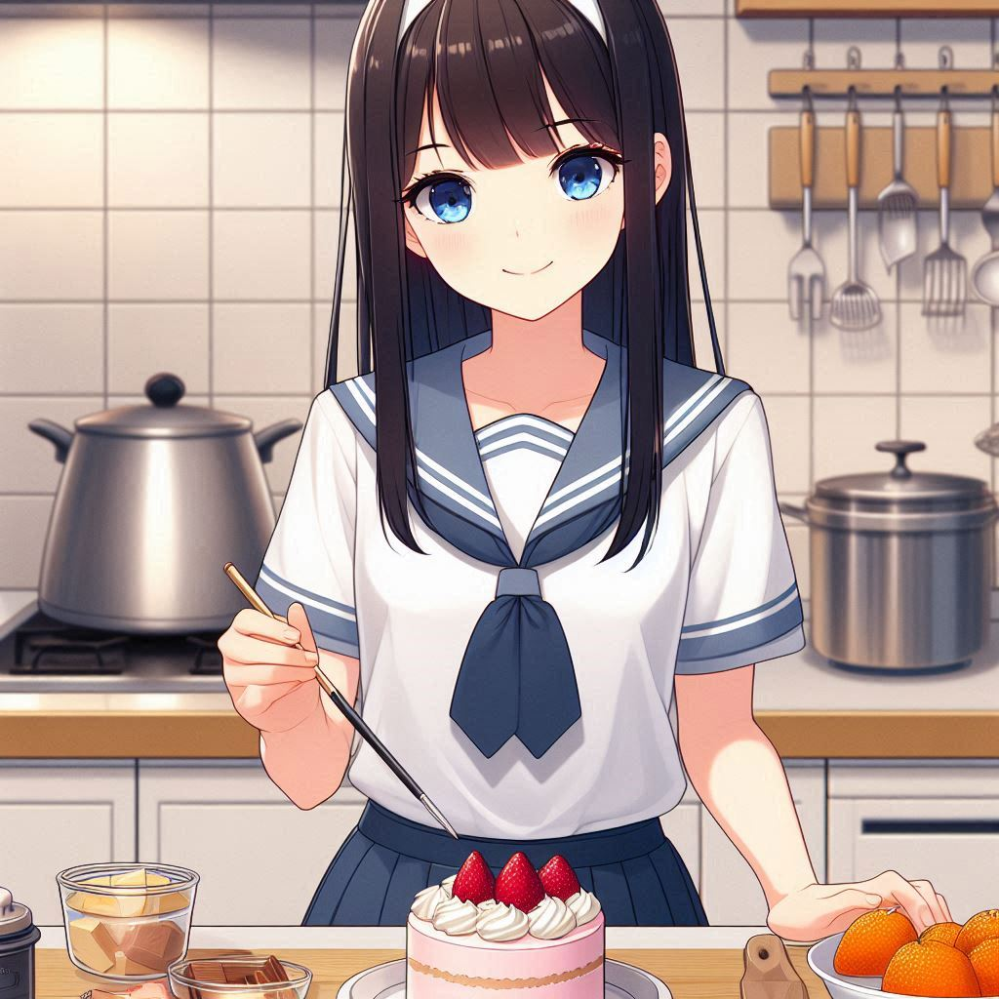
Notes:
Build a Japanese anime style scene. A girl makes dessert in the kitchen. Expression is clear and confident. The girl's appearance is chest-length straight black hair, flat bangs, and blue eyes. Wearing a white sailor suit.
儘管那次比賽我沒能獲勝，但我知道，這只是我的烘焙之路的開始，我會繼續走下去，用甜點創造更多美好的故事。

